Slide 1
Prevention of Batch Mix-Up Using Automated QR Scanning Jig
Name: Penke Lakshmana Sai Kaushik
Department: Quality Assurance
Subtitle: Real-Time Batch / Line Mix-Up Detection

Slide 2
Prevention of Batch Mix-Up Using Automated QR Scanning Jig
Objective of the Initiative:
Prevent batch mix-ups in production.
Identify incorrect cartridges before they move forward.
Implement real-time validation using existing automatic QR scanning jig.
Strengthen compliance, quality assurance, and traceability.

Slide 3
Prevention of Batch Mix-Up Using Automated QR Scanning Jig
Flow Chart:
Automatic Cartridge QR Scanning JIG
↓
Load Cartridges in Stacker
↓
QR Code Scanned by Jig
↓
It will check for : QR Code / Batch Range / Line / Count
↙ ↘
Pass → Move Forward Fail → Alert / Divert Cartridge
↓
Next Cartridge Drops
↓
Repeat the Process
If it is same batch cartridge
If it is different batch cartridge

Slide 4
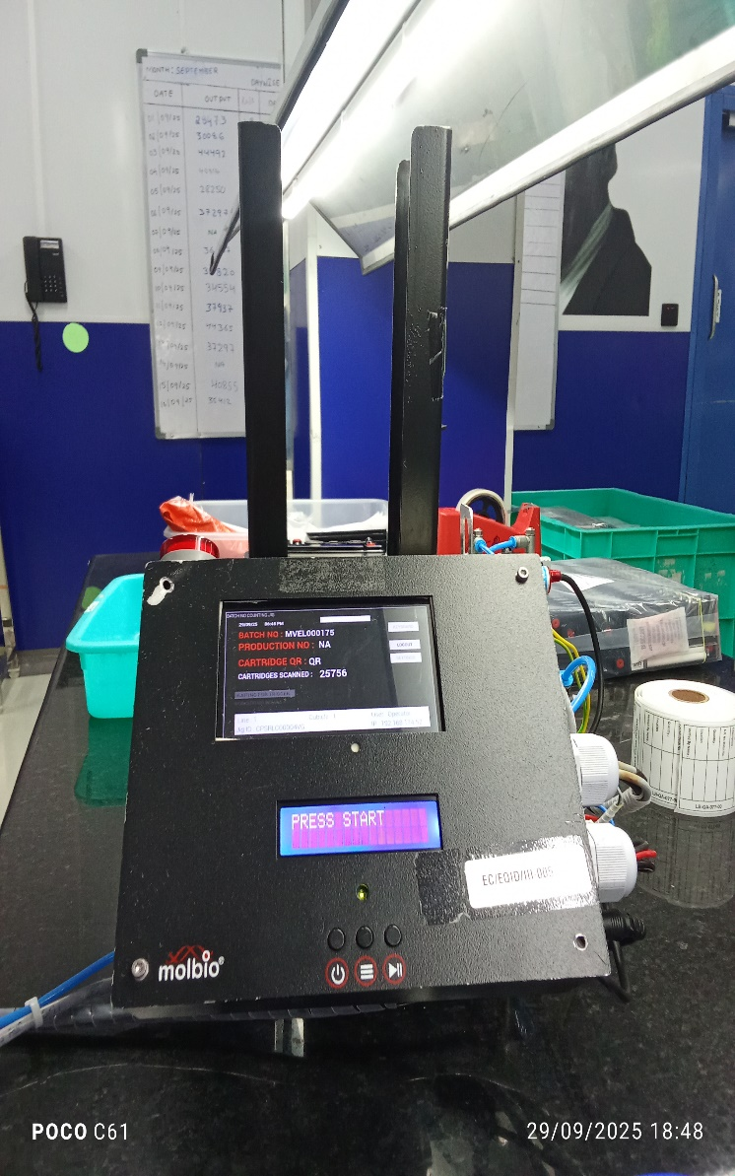
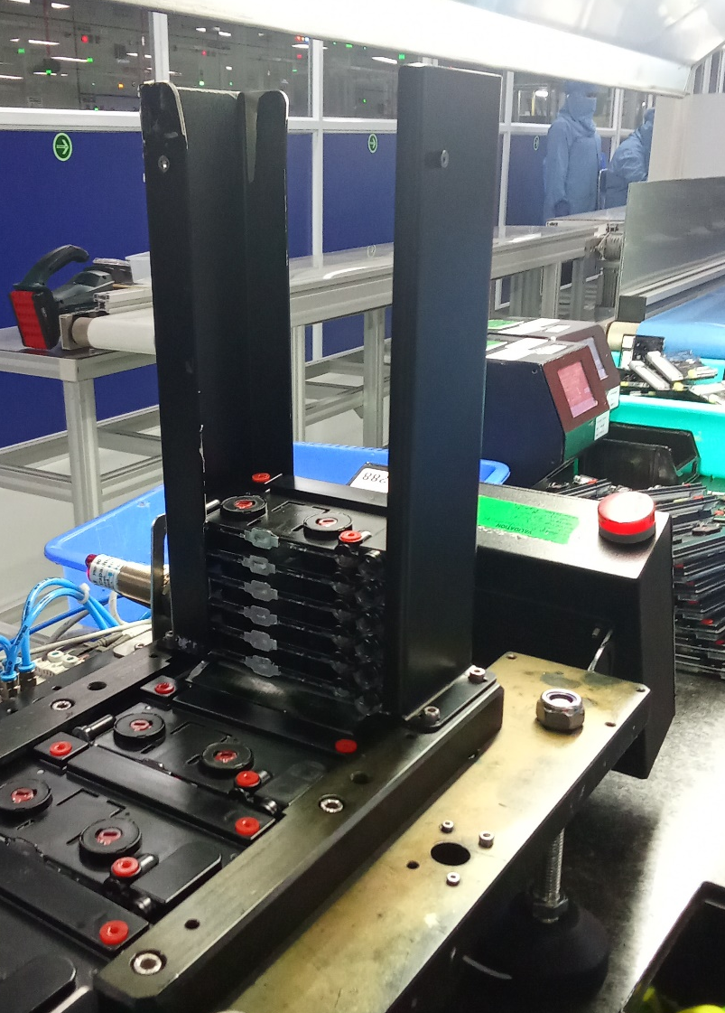
Prevention of Batch Mix-Up Using Automated QR Scanning Jig
Automatic Cartridge QR Scanning JIG
Load Cartridges in Stacker
Stage-1
Stage-2
Stage-3

Slide 5
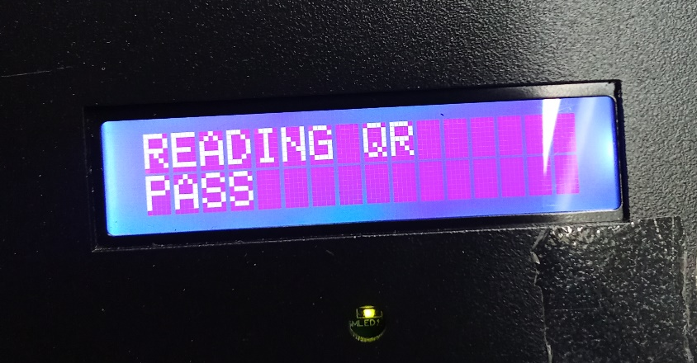
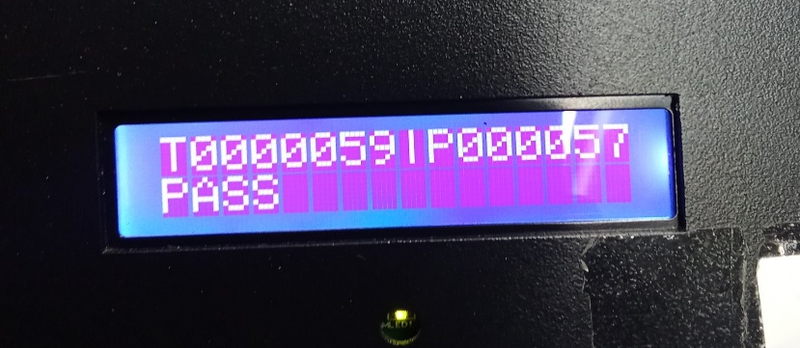
Prevention of Batch Mix-Up Using Automated QR Scanning Jig
Stage- 3
Automatically Scan QR
What it will check when cartridge is scanned:
Batch Input:
Batch = MVANC000012
Line = A
Range = VAN142536A0001 → VAN142536C0002
Scans:
VAN142536A0001 → ✅ Pass (within range).
VAN142536A5000 → ✅ Pass.
VAN142536C0002 → ✅ Pass (last QR).
VAN142536C0003 → ❌ Reject (outside range).
VAN142536B0100 → ❌ Reject (wrong line).
QR code is not from this batch it will Reject
Stage- 4
PASS
FAIL
If QR Code matched and within the range, it should pass
Stage- 5

Slide 6
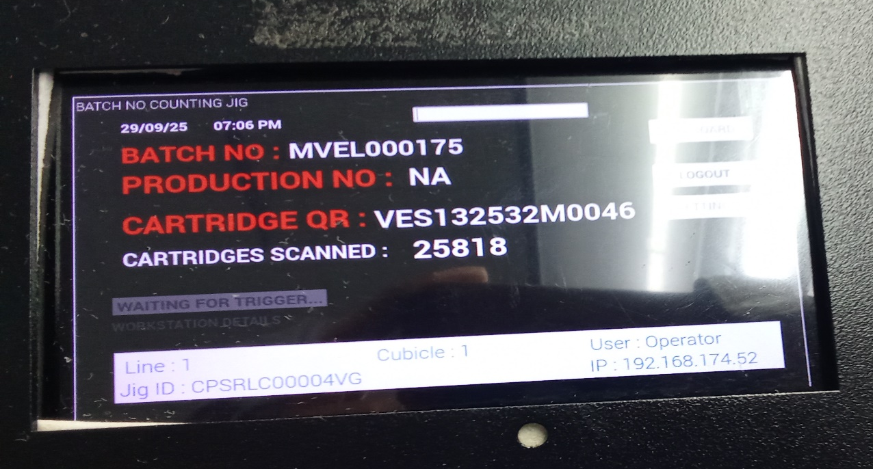
Prevention of Batch Mix-Up Using Automated QR Scanning Jig
It will display the details and count will increase if cartridge passed in stage 4.
Stage- 5
Date and Time
Batch Number
Cartridge QR Code
Total Scanned Count

Slide 7
Prevention of Batch Mix-Up Using Automated QR Scanning Jig
Scanning and Validation
Line Validation
  QR Line must match the batch line.
  ❌ If mismatch → Reject, Red Light blink
Range Validation
  QR Serial must be within the QR Range Start → QR Range End
  ❌ If outside → Reject, Red Light blink
Duplicate / Re-Scan Check
  If QR already scanned → ✅ Pass, Yellow Light blink
  Else → ✅ Pass, Green Light blink

Slide 8
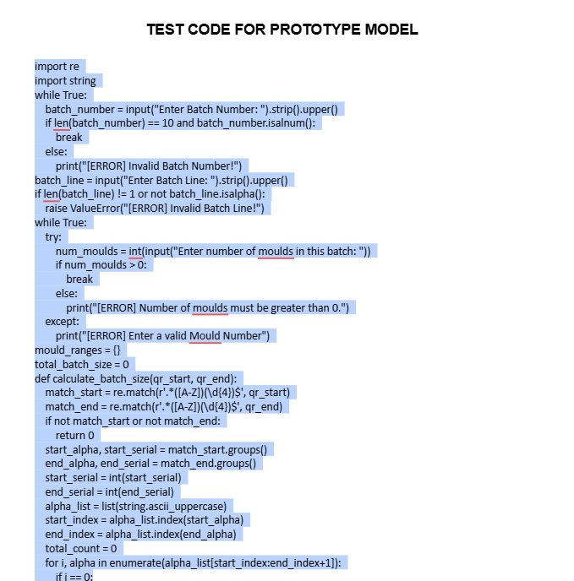
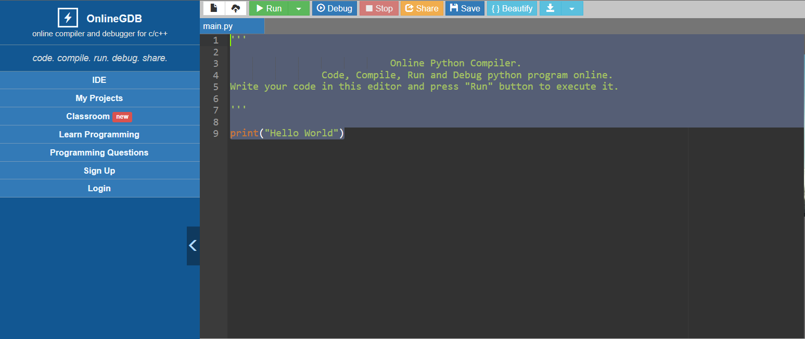
Prevention of Batch Mix-Up Using Automated QR Scanning Jig
PROTOTYPE MODEL
Open the link and copy the code.
https://docs.google.com/document/d/1wfazcp5uvZNXjJm_HsSERG-kLW0GoDAx/edit?usp=drive_link&ouid=107366926054555082251&rtpof=true&sd=true
Open Python online compiler and paste the code.
https://www.onlinegdb.com/online_python_compiler
Open the link and copy the code
Open python and Delete the existing code
Python Online compiler

Slide 9
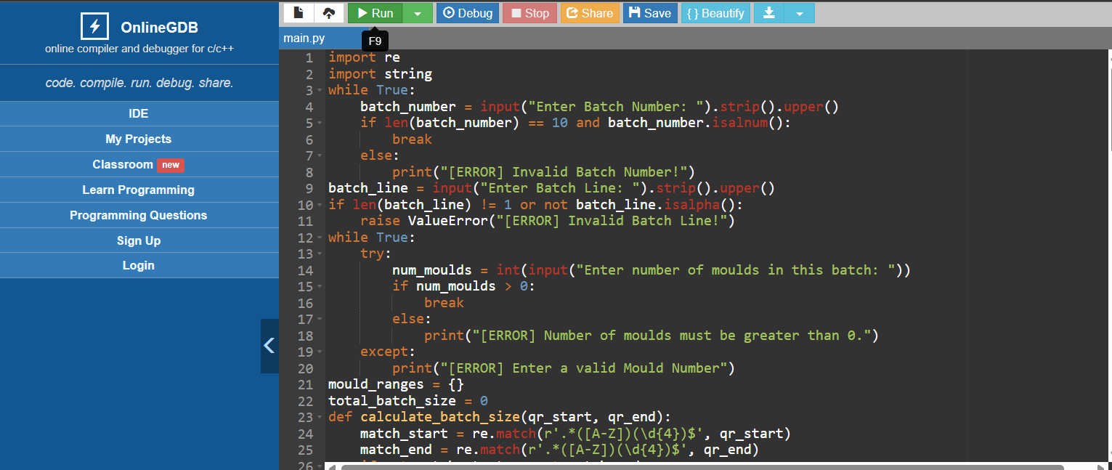
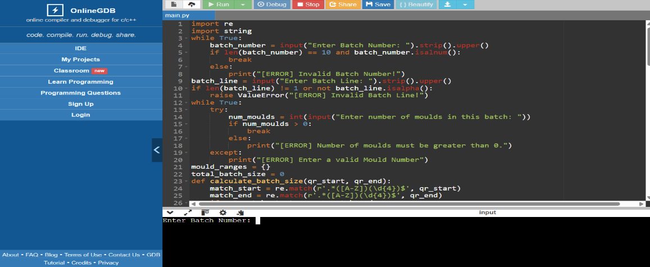
Prevention of Batch Mix-Up Using Automated QR Scanning Jig
Paste the code here
After pasting the code click on Run the code.

Slide 10
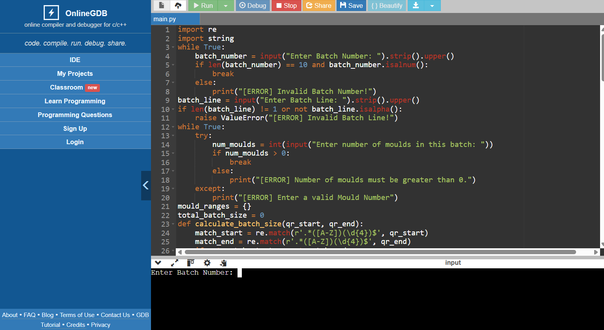
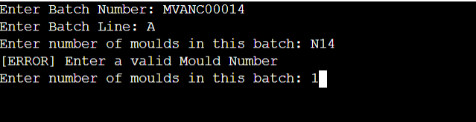
Prevention of Batch Mix-Up Using Automated QR Scanning Jig
After Run the code it will display like this.
After pressing run it will ask for details
Give the required details as shown, like Batch Number , Line etc..

Slide 11
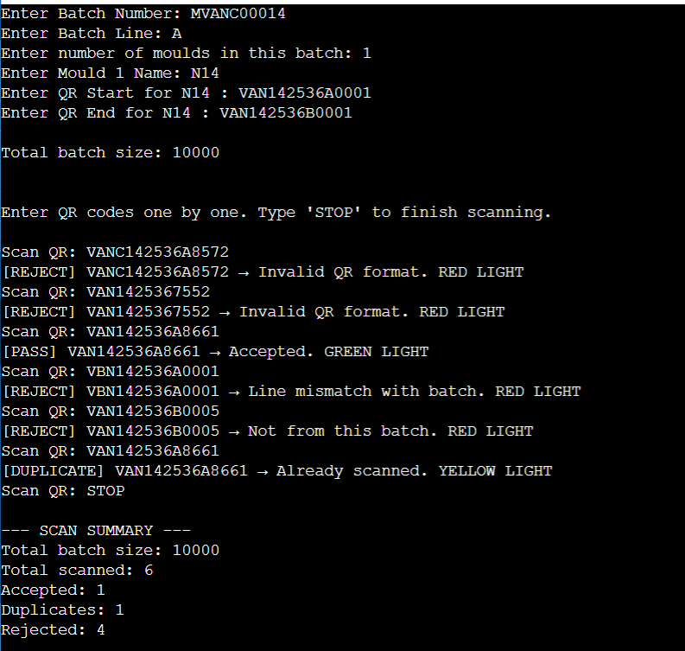
Prevention of Batch Mix-Up Using Automated QR Scanning Jig
Enter the details here
Enter the QR number here
After entering the QR code if it is not from the batch it will reject as shown.
After scanning all Cartridges type STOP and press Enter
The result will shown like this at the batch end

Slide 12





For more information:
www.molbiodiagnostics.com
Write us at:
@molbiodiagnostics.com
Call us at:
+91
Thank You
DISCLAIMER
This presentation has been prepared exclusively for information purposes only and is strictly confidential. The information and statistical data herein have been extracted from internal documents, publicly available information and/ or also obtained from sources the parties involved in the preparation of this presentation believe to be reliable but in no way are warranted by them as to accuracy or completeness. The parties involved in the preparation of this presentation accept no responsibility for any losses resulting from the use or transmission of the data or views represented in this presentation. The recipient is provided the information contained herein on a confidential basis which should not be disclosed to third parties or duplicated or used for any purpose.
The parties involved in the preparation of this presentation shall not be liable for the relevance, accuracy or completeness of the information contained herein, and disclaim any and all liability as to the information set forth herein or omissions here from, including, without limitation, any express or implied representation or warranty with respect to such information.

